Slide 1
Introduction to Emergency and Critical care
Mulualem Sitot (BSc, MSc in Anesthesia)
Assistant Professor, Department of Anesthesia
Addis Ababa University

Slide 2
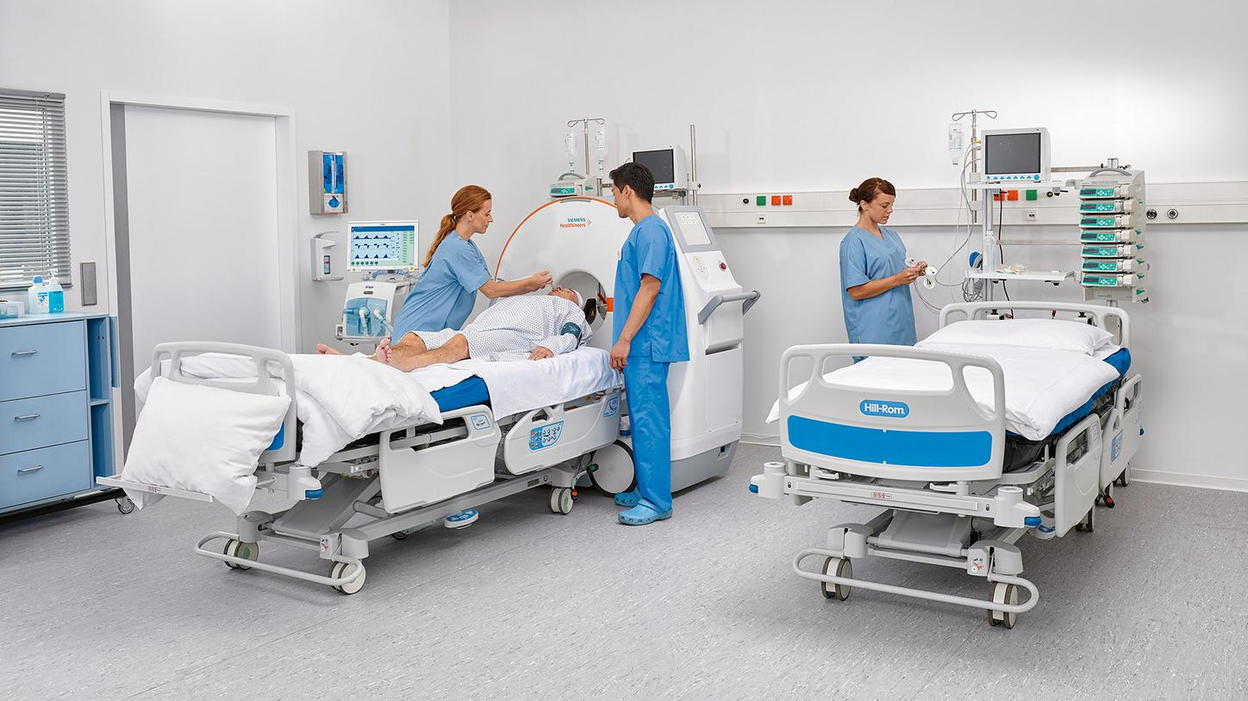

Slide 3
Outline
Objective
Introduction
Definition
Requirements For Intensive Care Unit
References

Slide 4
Objective
After completion of this session, you will be able to:
Define Intensive care unit (ICU)
Discuss requirements For ICU

Slide 5
Interactive question
What is critical care?
It is the care and management of critically ill patients who require
sophisticated support,
careful and constant monitoring, and
complex decision making to ensure that therapy is adjusted as patients’ needs change.

Slide 6
Introduction
Critical care medicine deals with potentially life-threatening illnesses.
Intensive care dates from the polio epidemic in Copenhagen in 1952.
The Intensive Care Unit (ICU) is an expensive resource area and
It should be reserved for patients with reversible medical conditions with a reasonable prospect of substantial recovery

Slide 7
Definition of ICU
ICU aka: an intensive therapy unit or intensive treatment unit (ITU) or critical care unit (CCU)
It is “a unit which provides service for patients with potentially recoverable conditions who can benefit from:
more detailed observation and
invasive treatment than can’t safely be provided in general wards or high dependency areas.”
Notes:
aka: also known as

Slide 8
Cont…
ICU is a specially staffed and equipped, separate and self-contained area of a hospital dedicated to:
the management of patients with life-threatening illnesses, injuries and complications,
and monitoring of potentially life-threatening conditions
(The Intensive Care Society (UK) (http://www.ics.ac.uk/ics-homepage/ guidelines-and-standards/

Slide 9
Cont…
It is reserved for patients with potential or established organ failure.
It provides special expertise and facilities for support of vital functions
It uses the skills of medical, nursing and other personnel experienced in the management of these problem
The most commonly supported organ is the lung,
but facilities should also exist for the diagnosis, prevention and treatment of another organ dysfunction.

Slide 10
Types of Intensive Care Units
While types of ICUs vary from hospital to hospital, some of the more common types of ICUs are:
medical intensive care units (MICU),
surgical intensive care units (SICU),
coronary care units (CCU),
Pediatric intensive care units (PICU), and
neonatal intensive care units (NICU).
Small hospitals may have only one or two types of ICUs accepting a variety of patients (e.g., MICU and SICU).
Notes:
The MICU generally accepts a wide variety of critically ill patients, excluding only those patients who can be managed in another available ICU setting, such as SICU or PICU. In smaller hospitals, where no other specialty units are available, pediatric patients and surgical patients are sometimes placed in the MICU.

Slide 11
Types of ICUs…
Name | Description
High dependency unit (HDU ) or intermediate care area, step-down unit, or progressive care unit | An intermediate ward for patients who require close observation, treatment and nursing care that cannot be provided in a general ward, but whose care is not at a critical stage to warrant an ICU bed. It is utilized until a patient's condition stabilizes to qualify for discharge to a general ward or recovery unit.
NICU | Cares for neonatal patients who have not left the hospital after birth.
Neurological ICU | Patients are treated for brain aneurysms, brain tumors, stroke, rattlesnake bites and post-surgical patients who have undergone various neurological surgeries performed by experienced neurosurgeons require constant neurological exams.
PICU | Pediatric patients are treated in this unit for life-threatening conditions such as asthma, influenza, diabetic ketoacidosis, or traumatic neurological injury
Post-anesthesia care unit (PACU) or recovery room | Provides immediate post-op observation and stabilisation of patients following surgical operations and anesthesia.
Trauma ICU | These are found in hospitals certified in treating major trauma with a dedicated trauma team equipped with the expertise to deal with serious complications.
SICU | A specialized service in larger hospitals that provides and primarily serves critically ill postoperative patients. As opposed to other ICUs, the care is managed by surgeons or anesthesiologists trained in critical-care.
Notes:
The PACU provides postoperative observation, monitoring of vital signs, medication administration, intravenous (IV) fluid administration, airway care, oxygen therapy, and extubation in patients ready for removal of the endotracheal tube, if not removed in the operating room. Recovery room nurses also provide the initial management of postoperative pain, treatment for postoperative nausea and vomiting, treatment of postanesthetic shivering, and monitoring of surgical sites for bleeding, swelling, discharge, or other complications. Occasionally, patients in the PACU require mechanical ventilatory support, generally for brief periods of time. Once stable, the PACU patient is transferred back to the general hospital ward or other care unit. In outpatient surgical settings, the patient may be discharged to home.

Slide 12
Levels of ICUs
Level 1 (Primary or Basic) ICU
It is the entry-level tier of intensive care found in smaller district or community hospitals
It is a unit capable of providing basic life support and monitoring.
Ward-based care where the patient does not require organ support
(for example, IV fluid, or oxygen therapy by face mask, vasopressors, non-invasive hemodynamic monitoring)
Should be capable of providing immediate resuscitation and short-term cardio-respiratory support for critically ill patients.
Staffing: usually staffed by medical officers and nurses with critical care training
Nurse-to-patient ratio: 1:3 or 1:4
e.g., small district hospital, small private nursing homes, and rural centers
Notes:
A High Dependency Unit is "a specially staffed and equipped section of an intensive care complex that provides a level of care intermediate between intensive care and general ward care."

Slide 13
Levels of ICUs….
Secondary (Level 2) ICU—HDU.
It is designed for patients who are seriously ill but stable.
Provide "general critical care: invasive monitoring and basic life support; support for a single failing organ.
Patient do not typically require life support (such as mechanical ventilation) but they need higher level of monitoring and nursing care.
Found in larger general hospitals
A HDU should have a minimum of 4 bed
Tertiary (Level 3) ICU—Advanced /Tertiary ICU
Provided at tertiary level hospitals.
Comprehensive critical care" is provided here, for an indefinite period.
Full life support; mechanical ventilation; multiorgan failure management; dialysis

Slide 14
Requirements For Intensive Care Units
Depending upon the
designated level
function
size and
case mix of the hospital and/or region that it serves
An ICU may range from four to over 50 beds.
Notes:
The definition of an ICU bed varies around the world, and even within a single health care system, and is heavily shaped by public health priorities and regulatory requirements, as well as by economic factors, including resource availability and approaches to hospital and physician reimbursement.

Slide 15
Cont.….
Staffing/Personnel
Specially trained physicians, nurses, and respiratory therapists are needed in order to staff the ICU.
Medical Staff (Intensivist-led teams)
Nursing Staff
The appropriate nurse to patient ratio and the total number of nursing staff required by each unit depends on many variables such as
the total number of patients,
severity of illness of patients,
methods of rostering,
as well as individual policies for support and monitoring in each unit.
Notes:
Nurses specifically trained in critical care should supervise all care carried out in the ICU. Nurse-to-patient ratios should be sufficient to safely deliver the care
required, based on patient acuity and complexity. Higher nurse-to-patient ratios (i.e., 1:1 or 1:2) have been associated with improved safety and better patient outcomes. Others have suggested evidence-based thresholds of not more than five patients for every two nurses.

Slide 16
Cont…
Other Staffs
physiotherapists, radiographers, dieticians, technicians (including biomedical engineering and scientific officers),
social workers/Aboriginal liaison/Maori liaison,
occupational therapists,
interpreters,
pastoral,
clerical and cleaning staff

Slide 17
Cont…
2. Operational
All units should be under the direction of a specialist in intensive care medicine.
This person should institute
agreed policies,
develop a team approach for management and be responsible to the hospital administration through appropriate channels

Slide 18
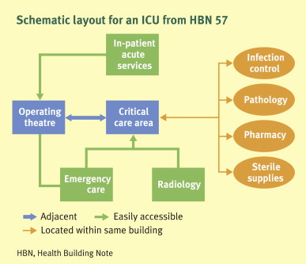
Cont…
3. Structure Of An ICU
Siting
The ICU should be a separate unit within the hospital with access:
to the emergency department, operating theatres, radiology, and interventional cardiology and trauma unit where relevant

Slide 19
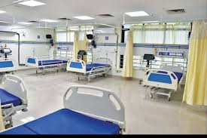
Cont…
Design
A high standard of intensive care medicine is influenced by good design and adequate space
Notes:
The physical space of an ICU should be large enough to comfortably accommodate the desired number of ICU beds. Each bed needs access from all sides to allow patient assessment and treatment and effective and reliable implementation of infection control measures. Ideally, each patient should be cared for in a single-bed room.
Each room should have a sink and incorporate design features to accommodate and provide easy access to supportive devices such as a ventilator and dialysis machine, as well as monitors. Oxygen and a suction system, preferably from a built-in system, should be available, and a source of natural light is desirable. Individual beds and rooms should be arranged in such a way that they are visible from a central nursing station and, where possible, should have sufficient space to allow family members to visit and even participate in the care of the patient.

Slide 20
Cont…
4. Equipment
The type and quantity of equipment will vary with the
type, size and function of the unit and must be appropriate to the workload of the unit.

Slide 21
Basic equipment should include:
ventilators for invasive and/or non-invasive ventilation
hand ventilating assemblies
suction apparatus
airway access equipment, including a bronchoscope and equipment to assist with the management of the difficult airway
vascular access equipment
monitoring equipment, both non-invasive and invasive
defibrillation and pacing facilities
equipment to control patient temperature
chest drainage equipment
infusion and specialized pumps
portable transport equipment
specialized beds
lifting/weighing equipment
access to ultrasound for placement of intravascular catheter

Slide 22
Cont…
5. Monitoring
Adequate monitoring is a core capability of all ICUs
Personnel
Clinical monitoring by a vigilant nurse is the basis of intensive patient care.
This should be supplemented by appropriate devices to assist the nurse.

Slide 23
Cont…
Patient Monitoring
Circulation
the circulation must be monitored at frequent and clinically appropriate intervals by
detection of the arterial pulse, ECG display and measurement of the arterial blood pressure.
Respiration
respiratory function should be assessed at frequent and clinically appropriate intervals by
observation, supported by capnography and blood gas analysis.

Slide 24
Cont…
Oxygenation
the patient’s oxygenation should be assessed at frequent and clinically appropriate intervals by
observation, pulse oximetry and blood gas analysis
Temperature
capacity to monitor central and cutaneous temperature
End tidal CO2 monitor
capnography must be available at each bed in the ICU and must be used to confirm:
tracheal placement of the ETT or tracheostomy tube
immediately after insertion, and continuously in patients who are ventilator dependent

Slide 25
References
ABC of intensive care. British Medical journal. 29 MAY 1999, VOLUME 318. Available at www.bmj.com.
https://en.wikipedia.org/wiki/Intensive_care_unit
https://derangedphysiology.com/main/required-reading/administration-and-data management/Chapter%20111/design-and-staffing-intensive-care-units.

Slide 26
THANK YOU

